Slide 1
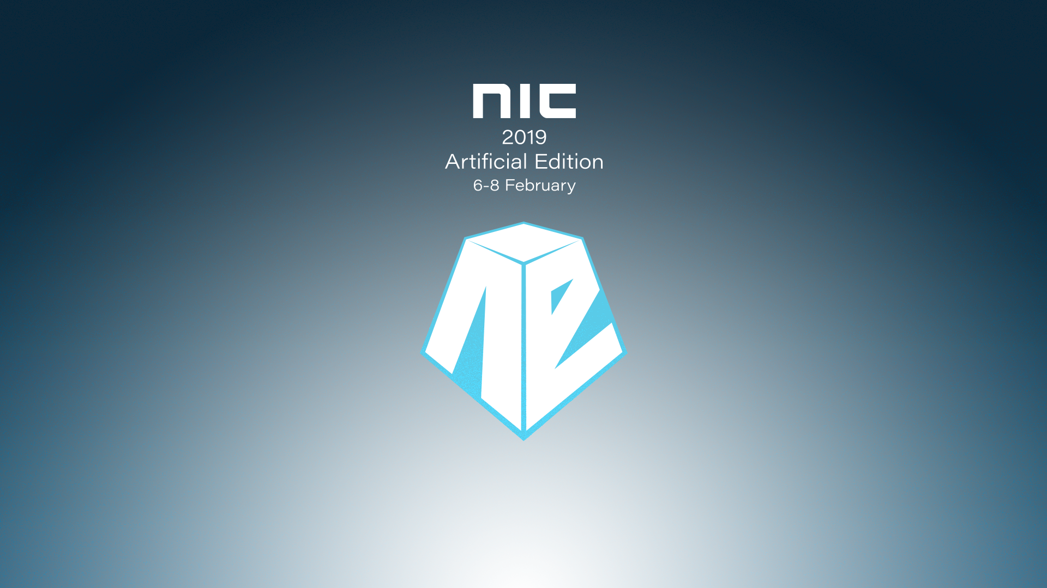

Slide 2


Building Lego with Terraform and Microsoft Azure
THIS SESSION DOES NOT ACTUALLY CONTAIN ANYTHING ABOUT LEGOS
Marius Sandbu Technical Cloud Lead @ EVRY

Slide 3

Agenda
Basic building blocks in Azure
Azure Resource Manager Layout
Terraform and Components
Why use Terraform and comparison with Resource Manager
Building Stuff in Azure using Terraform

Slide 4

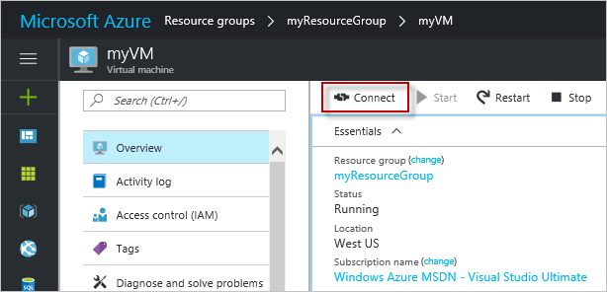
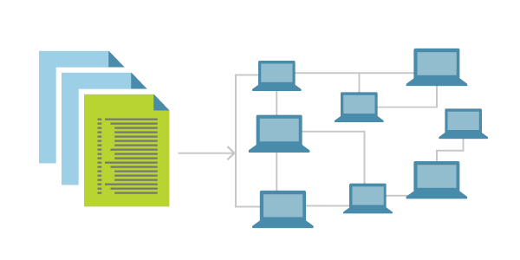
Infrastructure as code
Benefits Scalability – Reliability – Documentation - Performance

Slide 5
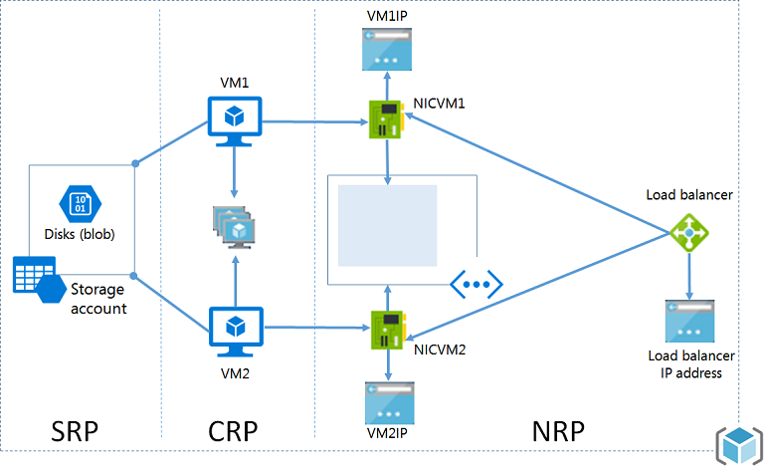
Azure - Building blocks
Azure Resource Manager
Automation and Management layer used for API access of resources in Azure using different Resource Providers
Resource Providers
A service that supplies the resources you can deploy and manage through Resource Manager
Resource Groups
Logical grouping of objects in Azure used for lifecycle management and role based access control and cost control

Slide 6
{
"$schema": "https://schema.management.azure.com/..json#",
"contentVersion": "1.0.0.0",
"parameters": {},
"variables": {},
"resources": [{
"type": "Microsoft.Resources/resourceGroups",
"apiVersion": "2018-05-01",
"location": “West Europe",
"name": "demo-storage",
"properties": {}
},
{
"type": "Microsoft.Storage/storageAccounts",
"name": "demo-storage",
"apiVersion": "2018-02-01",
"location": "West Europe",
"sku": {
"name": "Standard_LRS"
},
"kind": "Storage",
"properties": {}
}
]
}
Resource Group
What does an ARM Template look like?
Storage Account

Slide 7

Some issues working with ARM
JSON based – Not directly human readable
Need to define and know API version for resources
Which API Version does Azure Firewall require?
Has up until now been restricted to resource groups
Limited to Microsoft Azure and services
No support Application plattforms
Other CL used for other Cloud platform

Slide 8
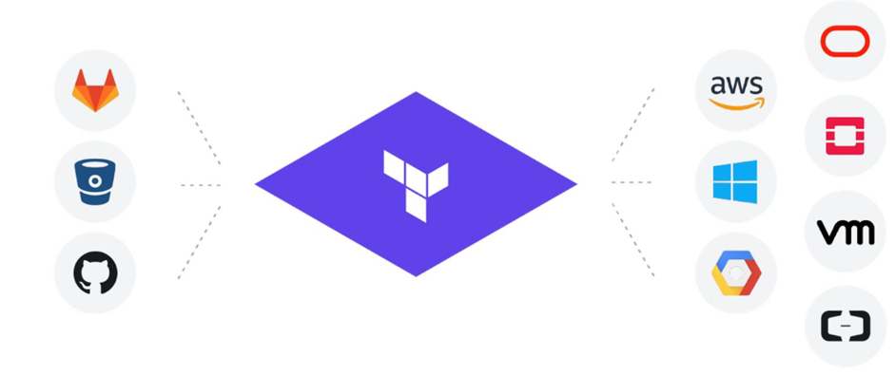
What is Terraform?

Slide 9
Terraform
Open Source Project by Hashicorp
Multicloud provider Infrastructure as Code Software
Example providers: AWS, Google Cloud, Azure, VMware
Uses either JSON or H(ashicorp)CL based syntax
Written in Go
Can be used for anything

Slide 10
The Hashicorp Ecosystem
Vagrant – Simplify building development enviroments
Packer – Building automated machine images
Sentinel – Policy as Code
Nomad – Scheduling and running applications
Vault - Securely accessing and storing secrets
Consul - Distributed service mesh and key store

Slide 11
resource "azurerm_resource_group" "testrg" {
name = "resourceGroupName"
location = "westus"
}
resource "azurerm_storage_account" "testsa" {
name = "storageaccountname"
resource_group_name = "testrg"
location = "westus"
account_tier = "Standard"
account_replication_type = "GRS"
}
Resource Group
Storage Account

Slide 12
Terraform Components
Providers: Integration to a specific platform
State: Metadata stored of current configuration
Backends: Storage location of Persistent State
Remote State
Azure Provider
Azure
Terraform
Google Provider
Google Cloud
Secrets
Kubernetes Provider
Kubernetes

Slide 13
Architecture with Hashicorp components
Packer
Build Image
Azure Provider
Push State
Consul (State)
Azure Provider
Azure
Key Value Store
Terraform
Vault (Secrets)
Push Secrets
Kubernetes Provider
Kubernetes

Slide 14

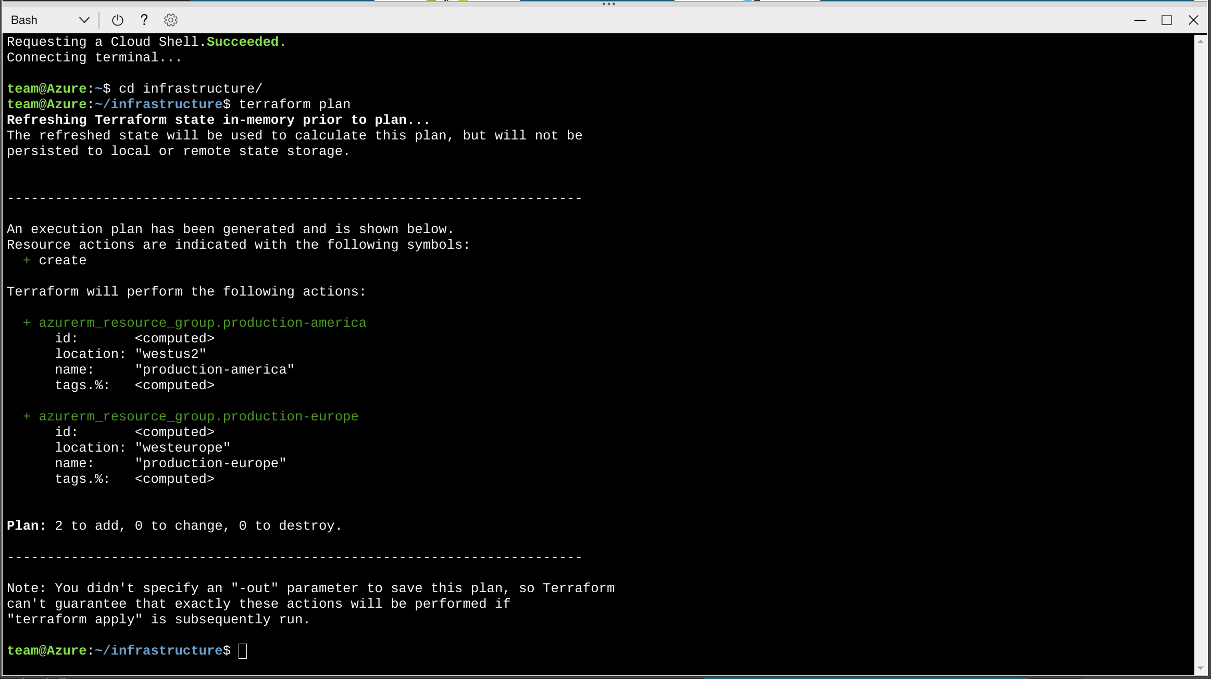
Getting up and running with Terraform
Get-PackageSource -Provider Chocolatey
Choco install Terraform
Choco install Git
Choco install vscode
Install-module az
Code --install-extension msazurermtools.azurerm-vscode-tools
Code --install-extension mauve.terraform

Slide 15
How to use it with Azure
Using Service Principal with Certificate or Secret
New-AzADServicePrincipal –Role Contrubitor -Scope /subscriptions/subscriptionid -Displayname something
Using MSI ( Managed Service Identity) within Azure
Using Azure CLI

Slide 16
Basic Terraform Commands
Terraform init – initializes working directory and checks/downloads providers
Terraform plan – creates an execution plan
Terraform apply – deploys and updates resources
Terraform destroy – removes all resources defined in a configuration
Terraform refresh – updates the state according to the actual configuration

Slide 17
Terraform and logical processing
Loads files within the directory alphabetically
Must be in .tf or .tf.json format
Declerative based
.tfvars file can be used to populate variables (similar to parameters)
Overrides can be made which will be loaded last must be placed within a *.override.tf file

Slide 18
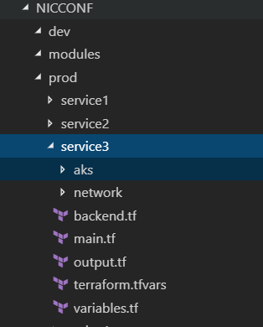
Terraform and layout example
Multiple Roots (Limit blast radius)
One Root per Application/Service
Having multiple SP can break Azure permissions
Do not check the following into source control
**/.terraform/*
*.tfstate
*.tfvars

Slide 19
Initial Configuration
Filename, can be anything must end in *.tf
main.tf provider "azurerm" {
version = "=1.21.0"
subscription_id = «subscriptionid»
client_id = «applicationid"
client_secret = «clientsecret»
tenant_id = «azureadtenantid»
}
Provider name and version
Service Principal for authentication

Slide 20
Modules and variables
Name of module
module "azure_provider" {
source = "./modules/azurepolicies"
name_prefix = "test"
allowed_regions = "${var.location}"
scope_of_policy_assignment = "${var.subscription_id}"
}
Local files, S3, Git, HTTP URL’s or Terraform Registry
Tfvars or var in runtime

Slide 21
Using remote state and secrets
terraform {
backend «consul» {
storage_account_name = "abcd1234"
container_name = "tfstate"
key = "prod.terraform.tfstate»
provider "vault" {
address = "https://fdqn"
token = "${var.token}"
}
Supports multiple state backends: S3, Blob, Consul, GCS
Supports multiple vault backends: S3, Blob, Vault, GCS

Slide 22
Working with multiple subscriptions
main.tf
provider "azurerm" {
subscription_id = «subscriptionid»
alias =first»
}
provider "azurerm" {
subscription_id = «subscriptionid»
alias =second»
}
Requires also application id, application secret and tenant id
Can also be used with multiple providers

Slide 23
Working with multiple subscriptions
provider "azurerm" { ... }
provider "azurerm" { ... }
resource "azurerm_resource_group" "first" {
name = "first-rg«
location = "West Europe»
provider = "azurerm.first" }
resource "azurerm_resource_group" "second« {
name = "second-rg«
location = «North Europe»
provider = "azurerm.second" }
Provider Alias does not work within a module ☹

Slide 24
What if?
I deploy resources outside of Terraform?
It doesn’t care, destroy will delete anything contained within a resource group for instance if that is part of configuration
https://github.com/andyt530/az2tf tool to convert ARM to Terraform HCL
I want to see deployment status of Terraform using Get-AzResourceDeployment?
Not reflected in either the portal or CLI
I want do deploy something that is not supported in Terraform?
Can still use ARM within Terraform for non-supported features, but it has some limitations

Slide 25
Terraform ARM template
resource "azurerm_resource_group" "test" {
name = "example-resources«
location = "West Europe"
}
resource "azurerm_template_deployment" "test" {
name = "example-template" resource_group_name = "${azurerm_resource_group.test.name}" template_body = "${file("arm-template.json")}"
parameters { "storageAccountType" = "Standard_LRS" }
deployment_mode = "Incremental"
}

Slide 26
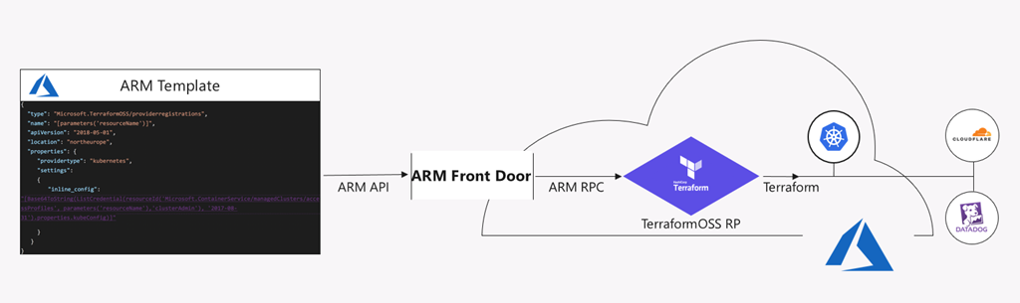
What about the ARM and Terraform provider?

Slide 27
What about the ARM - Terraform provider?
Provides access to Terraform providers trough ARM
Gives ARM access to 3.party resource provisioning
Currently supports Kubernetes, Cloudflare, Datadog
Still in Private Preview (Since May 2018???)

Slide 28
Some Gotcha’s with Terraform and Azure
Many are pushing complete modules into Terraform Registry
Wierd error messages → Check Azure Activity log "Error converting value \"ClientIP\" to type 'Microsoft.WindowsAzure.Networking.Nrp.Frontend
Azure only assignes dynamic IP addresses to running virtual machines, output empty.
Exceeding quota limit of core → Expand vCPU Quota in Azure
Azure RM Provider 2.0 coming soon
And… 326 other issues on GitHub → http://bit.ly/2D5PgtF

Slide 29
Demo
Demo 1 – Getting Terraform up and running with Azure
Demo 2 – Setting up Modules in Terraform
Demo 3 – ARM within Terraform
Demo 4 – Extending Ecosystem with Vault and Consul for State

Slide 30
Summary – Key differences
Terraform is using Go SDK from Azure, ARM is native
Not all Azure services are available in Terraform
https://github.com/terraform-providers/terraform-provider-azurerm/issues
Different storing of States (Provisioning speed)
Azure Resource Manager JSON vs HCL in Terraform
Application providers and Multi Cloud available in Terraform
Terraform is still young (0.12 coming Q1 – 2019)

Slide 31
Where can I learn more?
Slack Terraform Workspace http://bit.ly/2BcEDVB
Documentation for Azure Provider http://bit.ly/2RTDIUF
Hashicorp User Group MeetUp (Next week!) http://bit.ly/2CND6W7
Start writing your own provider? http://bit.ly/2G8X8h1
Terraform for the ARM developer http://bit.ly/2UJ3nMy

Slide 32

Is there more?
A bit more detailed blog post here →
https://msandbu.org/building-lego-with-terraform-on-azure-part-one/

Slide 33
Thank you!

